Slide 1
AI-Based Test Automation For Application Testing Using TestCraft

Slide 2

Introduction to AI-Based Test Automation
AI-based test automation enhances application testing efficiency and accuracy.
It leverages machine learning and artificial intelligence to streamline the testing process.
Organizations increasingly adopt AI tools like TestCraft for faster deployment and better quality.
1
Notes:
Image source: https://binmile.com

Slide 3
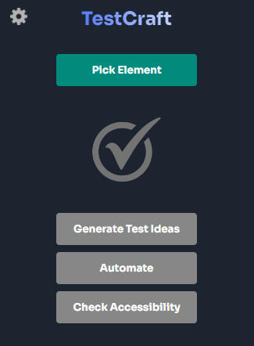
What is TestCraft?
TestCraft is a no-code test automation platform designed for web applications.
It integrates AI to create and maintain automated tests without extensive coding knowledge.
This makes it accessible for both technical and non-technical users, fostering collaboration.
2
Notes:
Image source: https://testautomationtools.dev

Slide 4
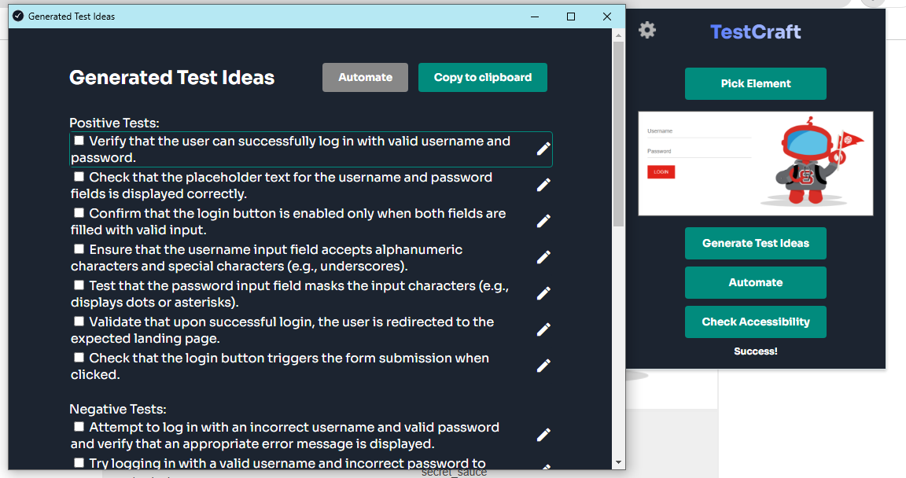
Key Features of TestCraft
TestCraft offers visual test creation, allowing users to drag and drop elements to build tests.
It automatically adapts to changes in the application interface, minimizing maintenance efforts.
The platform supports parallel test execution, significantly reducing overall testing time.
3
Notes:
Image source: https://images.softwaresuggest.com

Slide 5
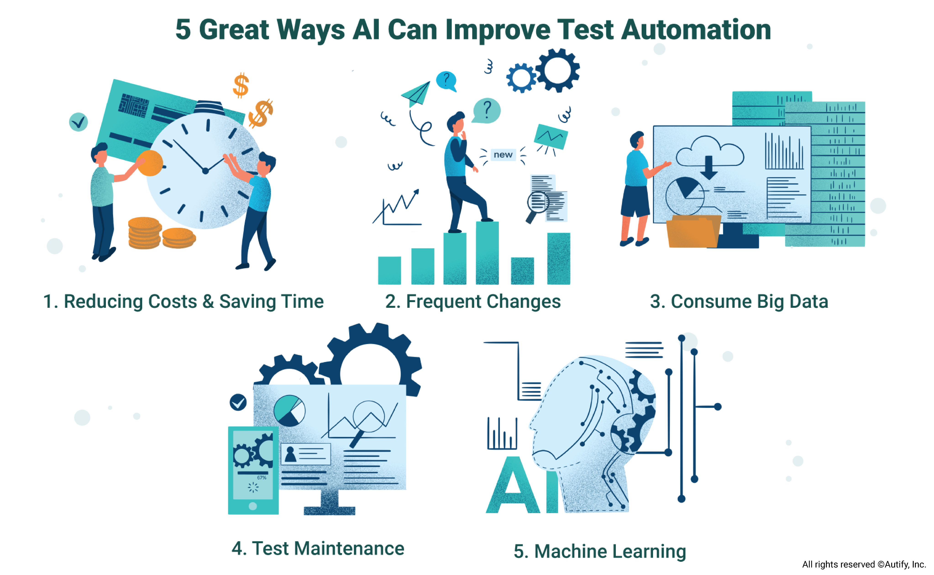
Benefits of AI in Test Automation
AI enhances test accuracy by minimizing human errors during test creation and execution.
It enables predictive analysis which helps to identify potential issues before they arise.
AI-driven insights can optimize test coverage and improve testing strategies over time.
4
Notes:
Image source: https://blog.autify.com

Slide 6
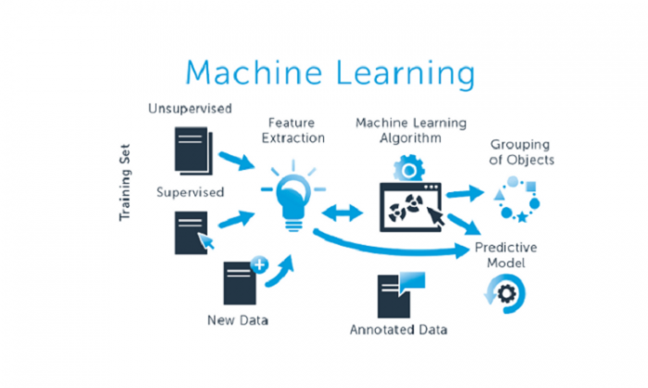
TestCraft's AI Capabilities
TestCraft utilizes machine learning algorithms to learn from past test executions.
The platform can automatically suggest improvements and optimizations for test cases.
It also provides intelligent reporting features that highlight key metrics and trends.
5
Notes:
Image source: https://techinshorts.com

Slide 7
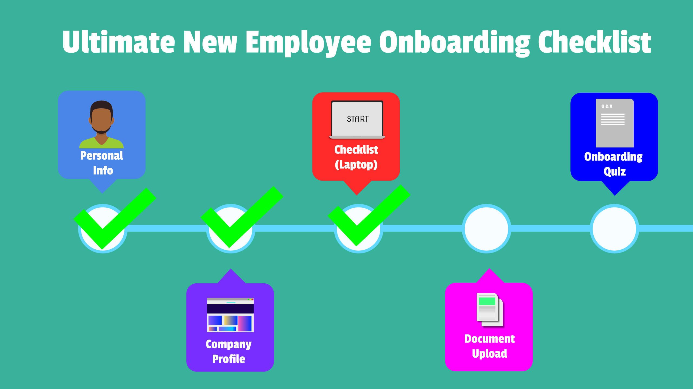
Getting Started with TestCraft
Setting up TestCraft involves a simple onboarding process with comprehensive documentation.
Users can create their first test in minutes, thanks to the intuitive interface.
Ongoing support and community forums help users troubleshoot and share best practices.
6
Notes:
Image source: https://www.creativewebmall.com

Slide 8
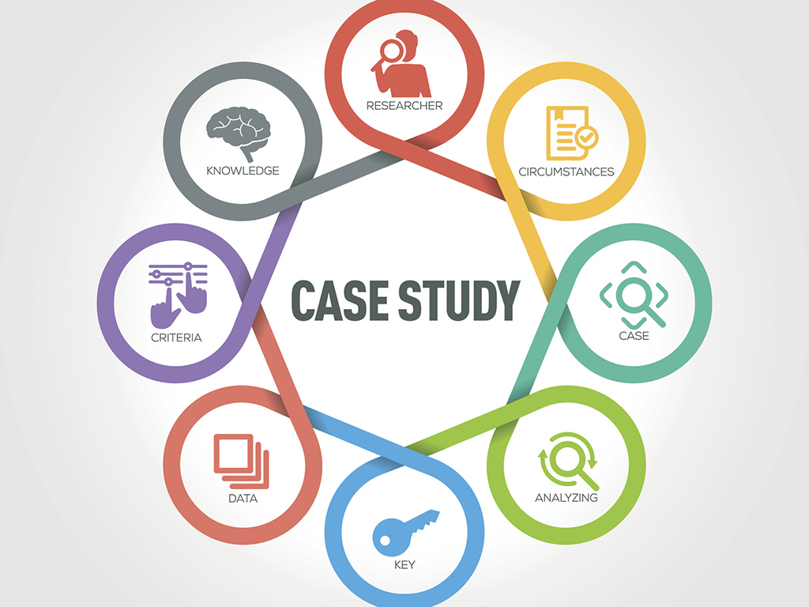
Real-World Applications and Case Studies
Companies across various industries have successfully implemented TestCraft for automation.
Case studies show significant reductions in testing time and costs while improving quality.
Organizations report enhanced collaboration between development and testing teams using TestCraft.
7
Notes:
Image source: https://www.purplepass.com

Slide 9
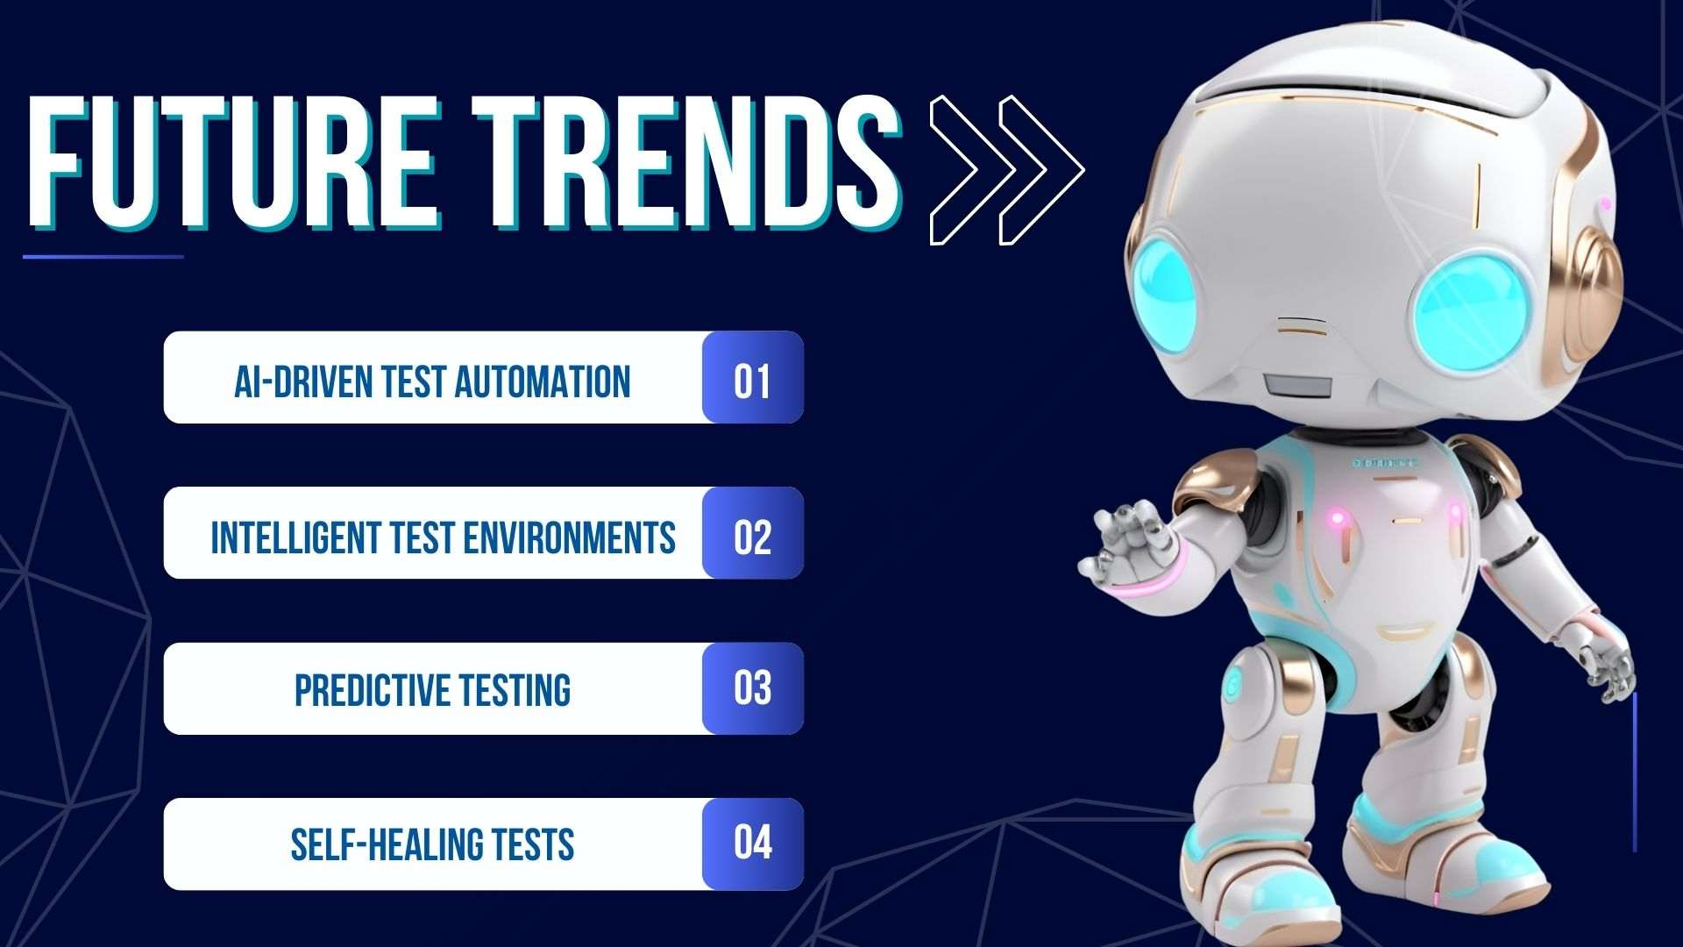
Future of Test Automation with AI
The future of application testing will increasingly rely on AI-driven tools for efficiency.
Continuous advancements in AI technologies will further enhance automation capabilities.
TestCraft is positioned to lead the way in making application testing smarter and more accessible.
8
Notes:
Image source: https://www.slidemake.com

Slide 10
References
TestCraft official website: https://home.testcraft.app/
AI in Software Testing: Trends and Predictions
9

